Slide 1

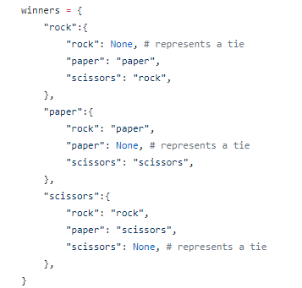
Rock Paper Scissors
Taking a game for your hands, to your hands.
Coders: Azeneth Mendoza, Matthew Mills

